Slide 1
eProcurement Ontology
2023 Q1
Online Presentation 09/03/2023
Eugeniu Costetchi, Andreea Pasare
Meaningfy/Infeurope

Slide 2
The goal of this meeting is to present:
(a) the work carried out since the last meeting in December
(b) the short-term plan for the first half of 2023
(c) the next modules to be evolved, eAccess and eContract.

Slide 3
Agenda
Welcome
Release 3.1.0 (December 2022)
Work carried out in 1st quarter 2023
- ePO core updates
- eOrdering
- eFulfilment
Plan for 2nd quarter 2023
- eAccess
- eContract
- ePO core updates
Planned releases
Open discussion
Closing

Slide 4
Release 3.1.0 (December 2022)

Slide 5
Release 3.1.0 (December 2022)
The release of version 3.1.0 and its corresponding technical files can be found here.
RDF representation of the eProcurement ontology can be downloaded here.
RDF representation of the eCatalogue module can be downloaded here.
RDF representation of the eNotice module can be downloaded here.
RDF representation of the eOrdering module can be downloaded here.
The documentation for this release can be found here.

Slide 6
Release 3.1.0 (December 2022)
Development of a new module, eOrdering
Updates for eCatalogue module
Included notice systematisation in eNotice module
ePO core updates:
- Procurement Objects (Procedure, PlannedProcurementPart, Lot)
- Roles hierarchy restructure
model2owl updates:
- Combined glossary
- Providing Turtle output files
- Implemented metadata management mechanism
GitHub issues revision and labelling
GitHub issue fixes for Q4 2022 milestone
Updates for standard forms mappings - TED-RDF-mapping

Slide 7
Work carried out in 1st quarter 2023

Slide 8
ePO core updates

Slide 9
ePO core updates
Differentiating between Procedure and Lot for Procurement Criteria.
Rethinking the Channel concept
Added new roles (e.g. Candidate)
Implementing a new methodology for GitHub issues revision and labeling
GitHub issue fixes for Q1 2023 milestone
Updates for standard forms mappings - TED-RDF-mapping

Slide 10
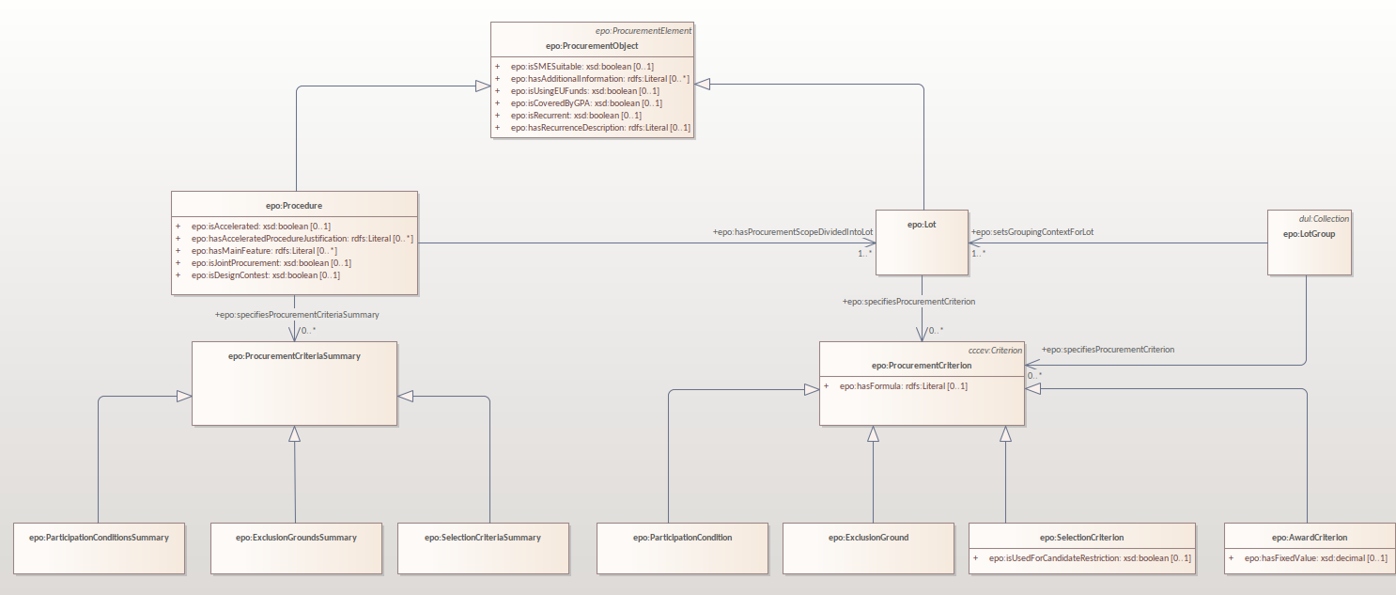
Procurement criteria summary
Github issue:
https://github.com/OP-TED/ePO/issues/420

Slide 11
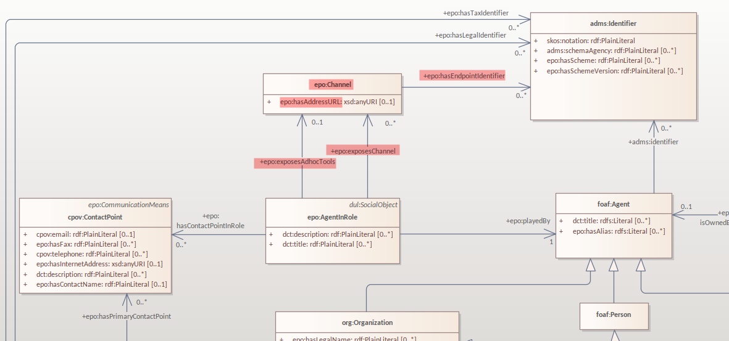
Channel concept
Github issue:
https://github.com/OP-TED/ePO/issues/435
Notes:
Used for notices and ordering

Slide 12
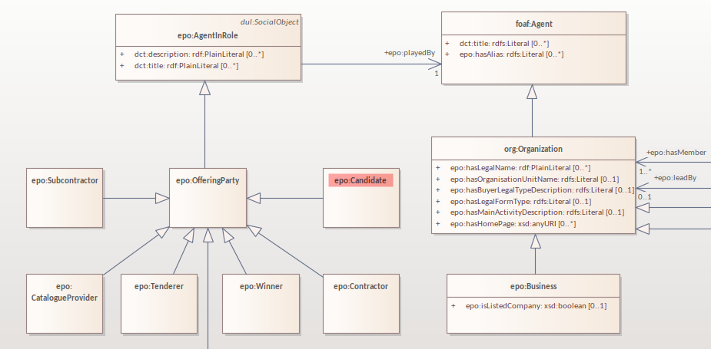
Candidate role
Github issue:
https://github.com/OP-TED/ePO/issues/174
https://github.com/OP-TED/ePO/issues/436
Definition of the Candidate role:
The role of an agent that has sought an invitation or has been invited to take part in a restricted procedure, in a competitive procedure with negotiation, in a negotiated procedure without prior publication, in a competitive dialogue or in an innovation partnership.

Slide 13
eOrdering updates

Slide 14
eOrdering
Order reponse development (https://docs.peppol.eu/poacc/upgrade-3/profiles/28-ordering/)
Checking completeness of eOrdering modelling (https://docs.peppol.eu/poacc/upgrade-3/2022-Q4/syntax/Order/tree/)

Slide 15
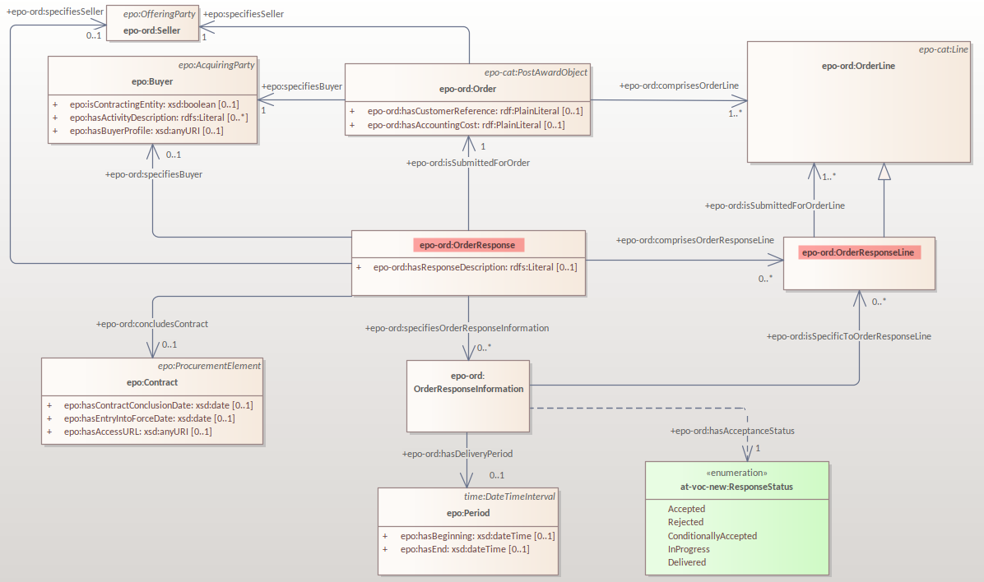
eOrdering – Order Response

Slide 16
eFulfilment

Slide 17
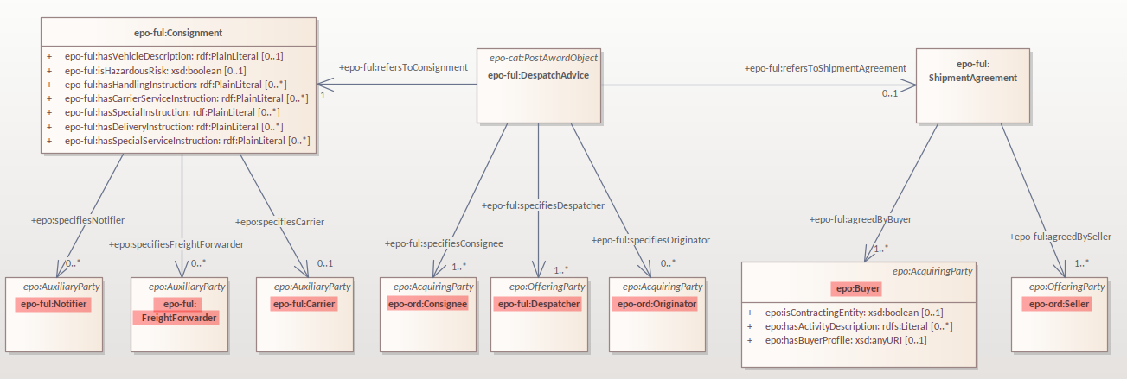
eFulfilment - Roles

Slide 18
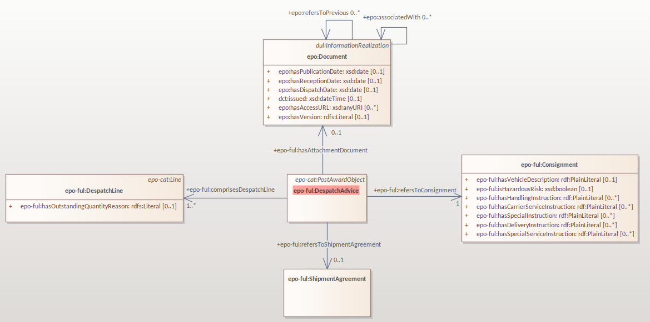
eFulfilment – Despatch advice

Slide 19
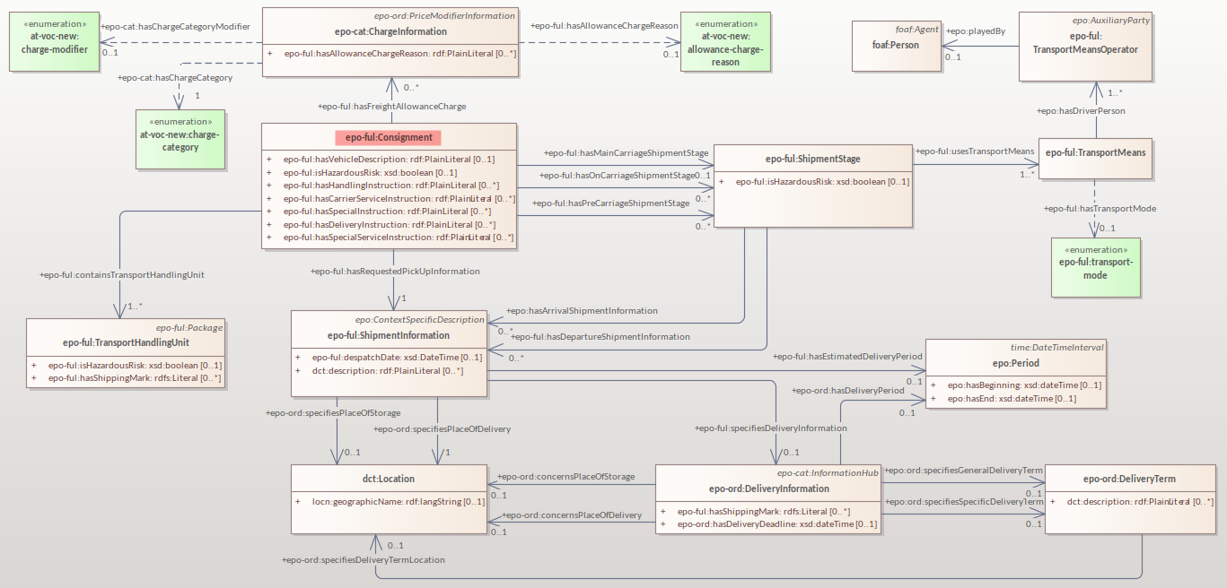
eFulfilment - Consignment

Slide 20
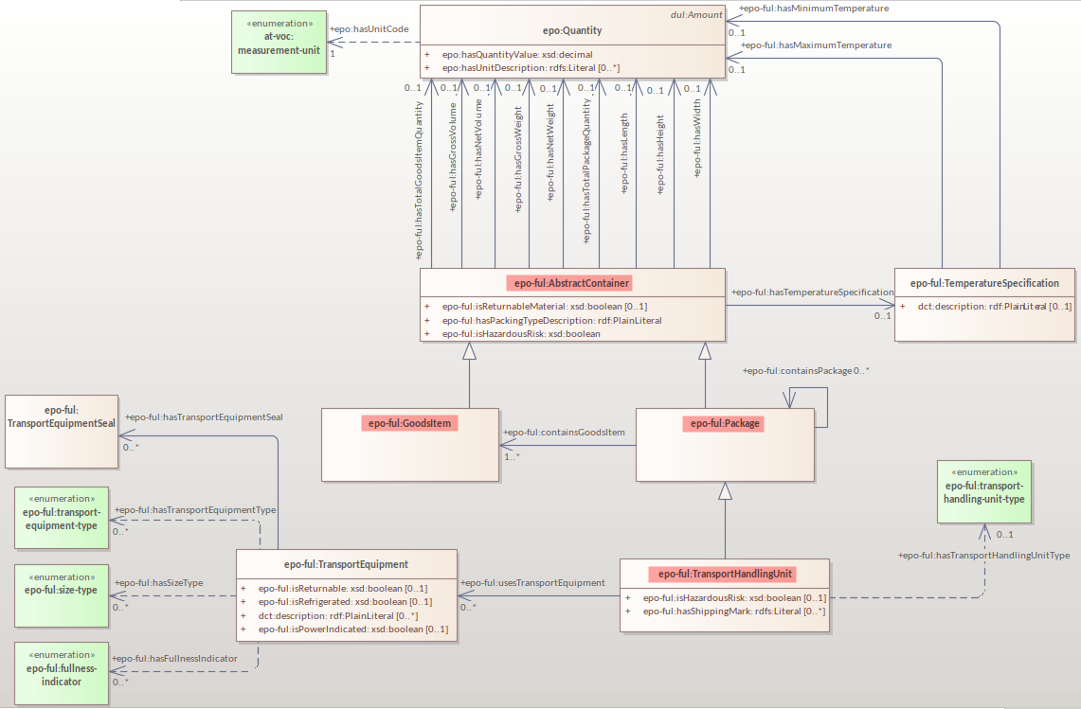
eFulfilment - Abstract container

Slide 21
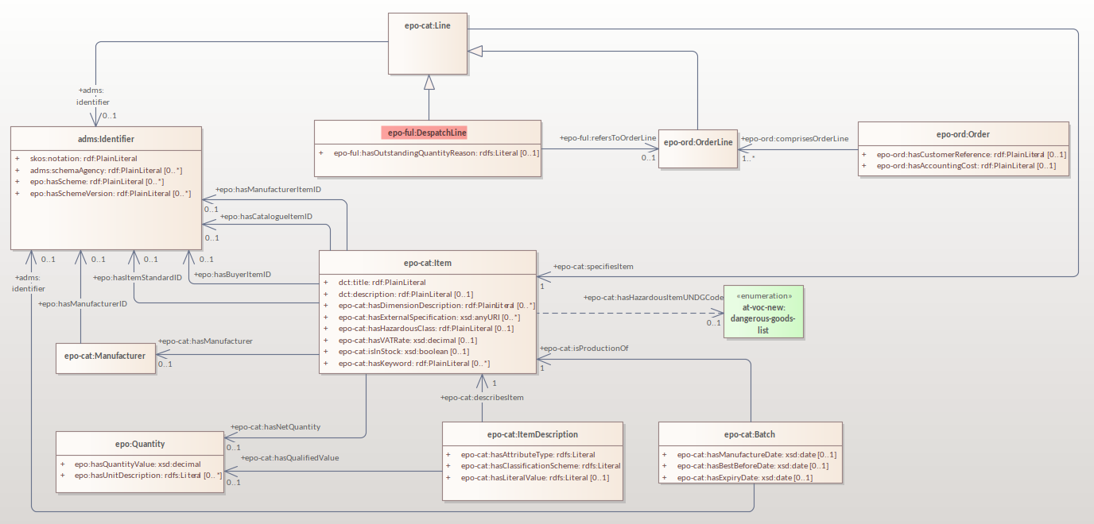
eFulfilment - Despatch advice line

Slide 22
5 min break

Slide 23
Plan for 2nd quarter 2023

Slide 24
Plan for 2nd quarter 2023
eContract
- ensure coverage of competency questions for Modification and Contract Completion Notices
eAccess
- ESPD request and procurement documents
ePO core updates
- Rethinking Procedure and Lot model
- GitHub issue fixes for 2023 Q2 milestone
model2owl updates
Updates for standard forms mappings - TED-RDF-mapping

Slide 25
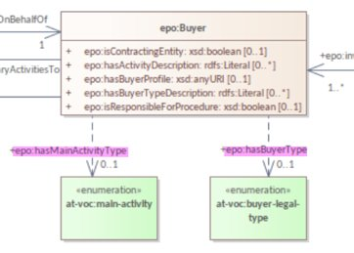
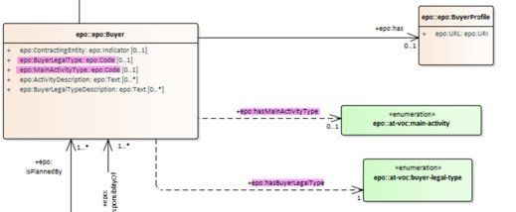
model2owl updates
Update the UML conventions and the related documents.
Update the transformation scripts based on the updates of the documentation:
- Conventions checking
- OWL core generation
- OWL restrictions generation
- SHACL generation

Slide 26
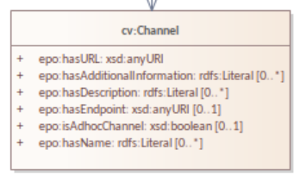

model2owl updates
Fix the bugs and the technical debt:
- Implement automated testing
- Refactor code for modular organisation
- Fix handling of unknown prefixes
- Fix handling of multiple domains and ranges for a property
- Fix handling relations across modules
Migrate from PDF documentation to HTML format.

Slide 27
Procedure and Lot model

Slide 28
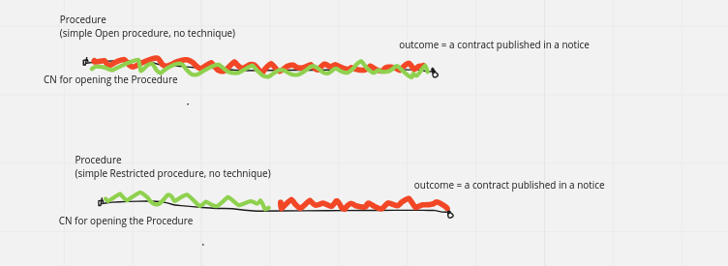
Open and restricted procedures without techniques

Slide 29
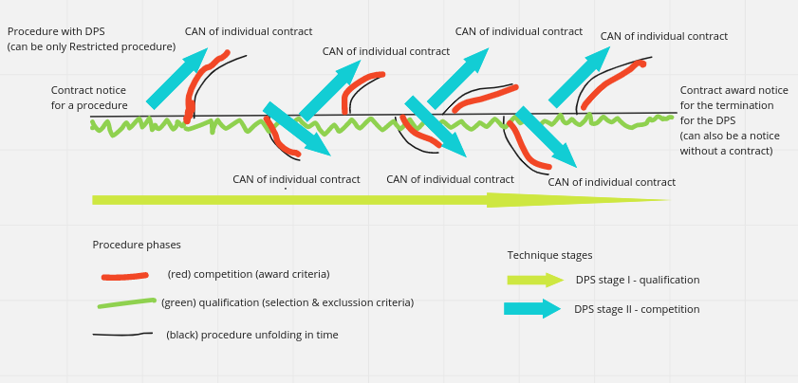
Procedure with Dynamic Purchasing System Technique

Slide 30
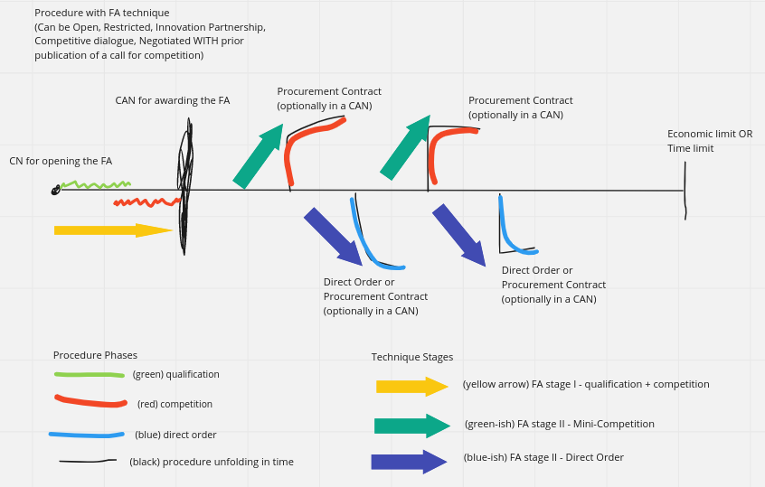
Procedure with Framework Agreement Technique

Slide 31
Planned releases

Slide 32
Planned releases
3.2.0
(Release in May 2023)
4.0.0
(Release in August 2023)
4.1.0
(Release in December 2023)
3.2.0 beta
(Pre-release in April 2023)
4.0.0 beta
(Pre-release in June 2023)
4.1.0 beta
(Pre - release in November 2023)
Notes:
Change beta under the line

Slide 33
Open discussion

Slide 34
Meeting schedule
Regular ePO Working Group meetings:
- every Tuesday from 14:30 to 16:30 (EET)
- meeting link
Specific ePO Working Group meetings:
- every other Thursday from 14:30 to 16:30 (EET)
- meeting link
Quarterly seminars:
- Tues 13 or Thurs 15 June (afternoons)
- Tues 5 or Thurs 7 September (afternoons)
- Tues 5 or Thurs 7 December (afternoons)

Slide 35
Feedback and questions
Looking forward to hearing from you.
Feedback and questions can be sent via:
GitHub issues: https://github.com/OP-TED/ePO/issues
or alternatively via:
Email: OP-EPROCUREMENT-ONTOLOGY@publications.europa.eu
Email: natalie.muric@publications.europa.eu

Slide 36
THANK YOU

